Slide 1
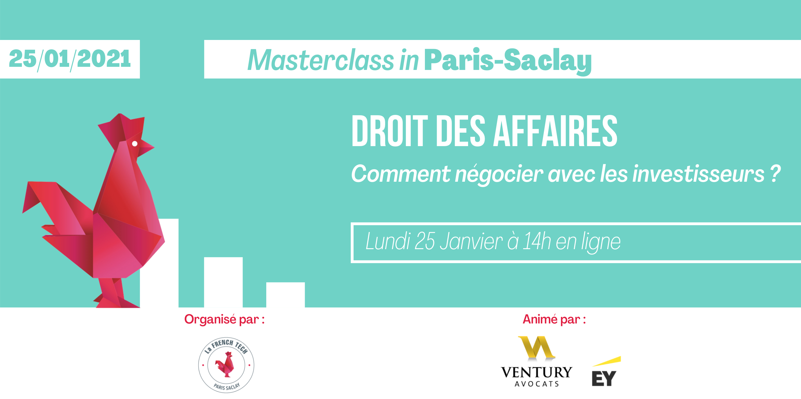

Slide 2



Slide 3
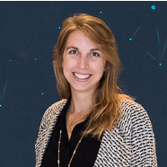
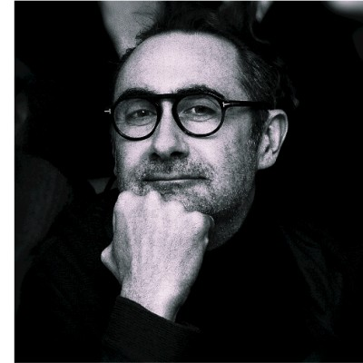
Soline QUIDET
Avocate Manageur
EY Ventury Avocats
Nicolas Ivaldi
Avocat - Associate Partner
EY Ventury Avocats

